Slide 1
Chapter 1 The Role of the Algorithms in Computing
Chi-Yeh Chen
陳奇業
成功大學資訊工程學系

Slide 2
Algorithms
Algorithm: Any well-defined computation procedure that takes some value, or set of values, as input and produces some value, or set of values, as output.
Input
(value or set of values)
Procedure
Output
(value or set of values)

Slide 3

Algorithms
Example: Sorting problem
Input: A sequence of n numbers $\left\langle a_{1},a_{2},…,a_{n}\right\rangle$
Output: A permutation $\left\langle a_{1}^{′},a_{2}^{′},…,a_{n}^{′}\right\rangle$ of the input sequence such that $a_{1}^{′}≤a_{2}^{′}≤…≤a_{n}^{′}$

Slide 4
An instance of a problem consists of the input needed to compute a solution to the problem.
An algorithm is said to be correct if for every input instance, it halts with the correct output.
A correct algorithm solves the given computational problem. An incorrect algorithm might not halt at all on some input instance, or it might halt with other than the desired answer.

Slide 5
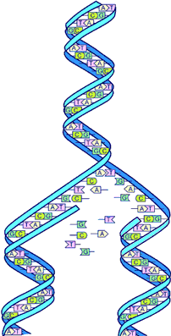

What kind of problem can be solved by algorithm?
The Human Genome Project
Identifying all the 100,000 genes in human DNA
Determining the sequence of 3 billion chemical base pairs that make up human DNA
Storing information in human DNA databases
Developing tools for human DNA data analysis

Slide 6

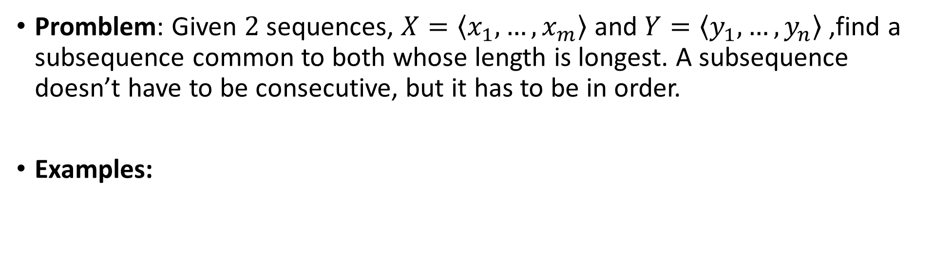



Longest common subsequence
Promblem: Given $2$ sequences, $X=\left\langle x_{1},…,x_{m}\right\rangle$ and $Y=\left\langle y_{1},…,y_{n}\right\rangle$ ,find a subsequence common to both whose length is longest. A subsequence doesn’t have to be consecutive, but it has to be in order.
Examples:
s p r i n g t i m e
p i o n e e r

Slide 7
What kind of problem can be solved by algorithm?
The Internet Applications
Internet enables people to quickly access and retrieve large amounts of information
Finding good routes on which the data will travel (CH24 Shortest Paths)
Using a search engine to quickly find pages on which particular information resides (CH11 Hash tables, 32 String Matching)

Slide 8
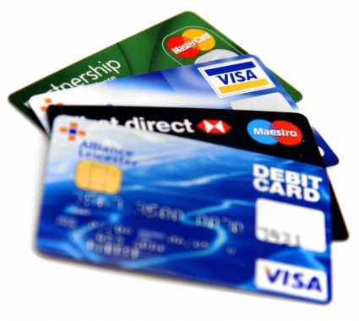

What kind of problem can be solved by algorithm?
Electronic Commerce with Public-key Cryptography and Digital Signatures (CH31 Number-Theoretic Algorithms)
Electronic commerce enables goods and services to be negotiated and exchanged electronically
Credit card numbers
Passwords
Bank statements private

Slide 9


What kind of problem can be solved by algorithm?
Manufacturing and Other Commercial Settings
Allocating scarce resources in the most beneficial way
How to assign crews to flights for an airline company?
Where to place its wells for an oil company?
Where to spend money buying advertising?
Where to place more resources for an Internet service provider?

Slide 10

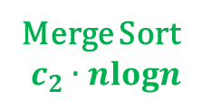
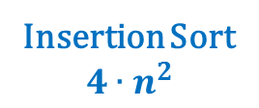

What kind of problem can be solved by algorithm?
Efficiency
Algorithms devised to solve the same problem often differ dramatically in their efficiency
These difference can be significant than differences due to hardware and software
E.g., Sorting n items
Faster Computer
Slower Computer

Slide 11





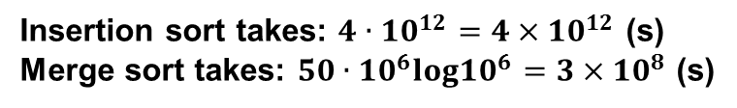


What kind of problem can be solved by algorithm?
Efficiency
These difference can be significant than differences due to hardware and software
Faster Computer
Slower Computer
Faster Computer
Slower Computer

